Slide 1
NAACP ASVA State/State-Area Conference Meeting
Project 2025 Impacts

Slide 2
Cedric
Haynes
Vice President,
Global Policy and Legislation
NAACP

Slide 3
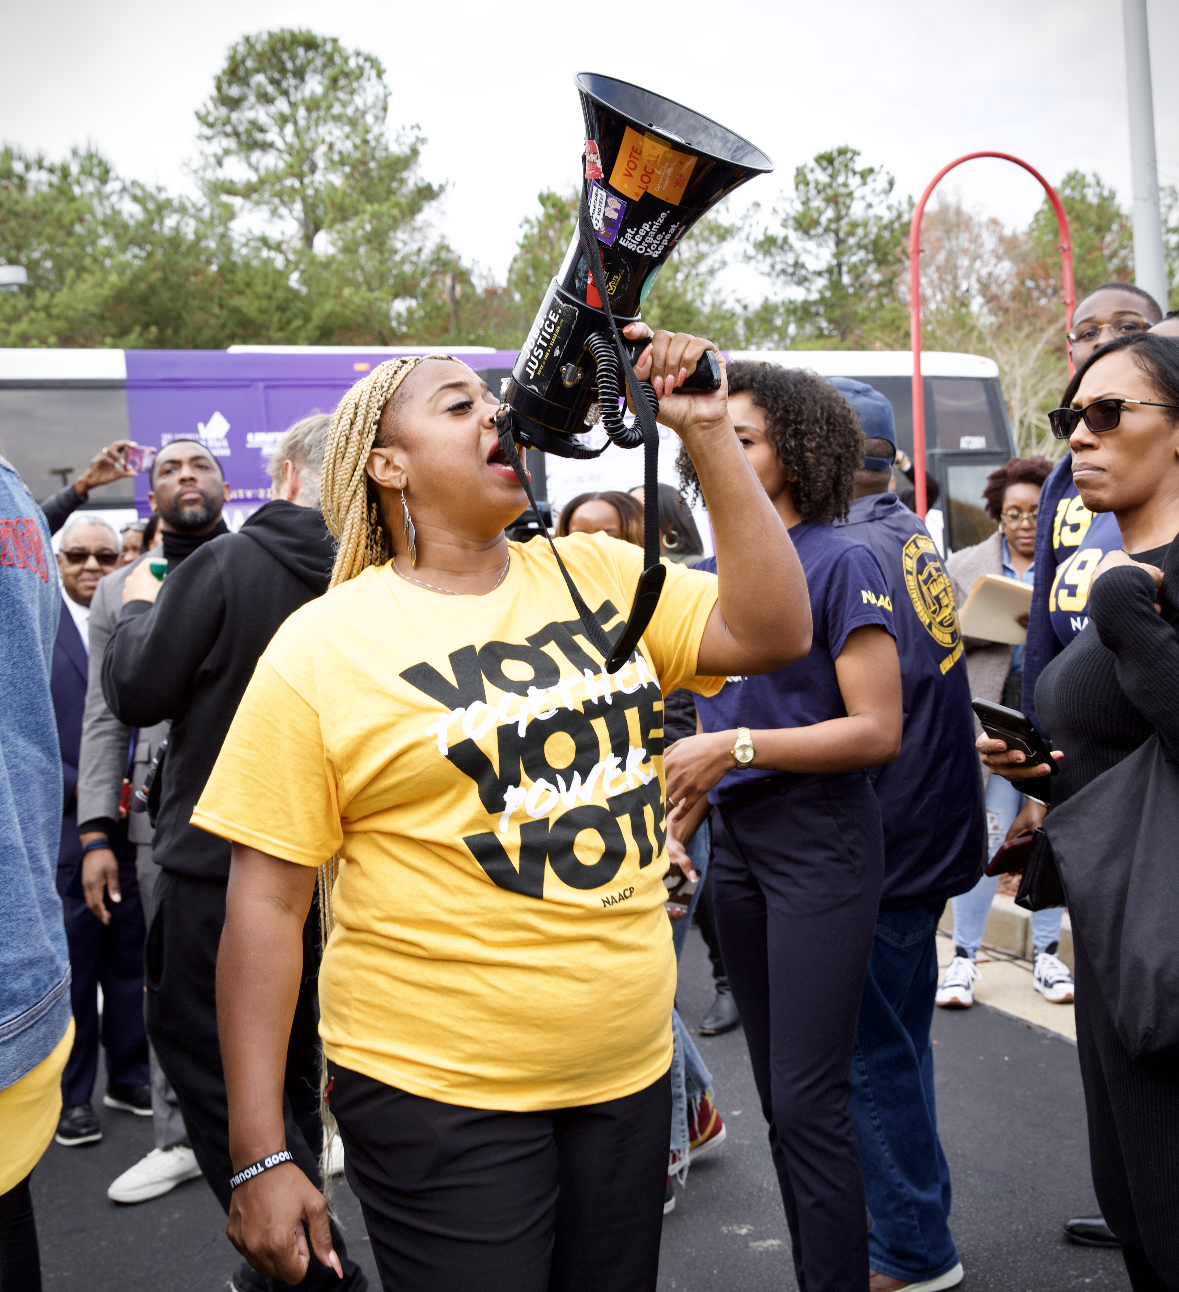
"We are nonpartisan, but we are political as hell,
and we know this is a fight we must take on."
- President Derrick Johnson

Slide 4
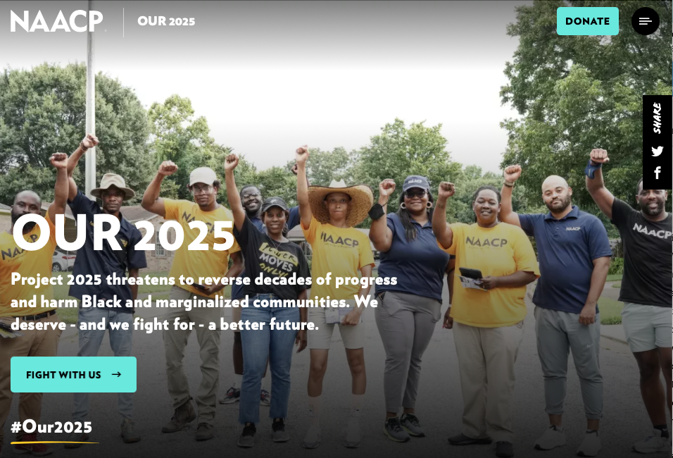
#Our2025: Get Involved
Policy Positions
Talking Points
Details on NAACP's proposed policy alternatives.
Guidance for how we talk about Project 2025 and our proposals.
Toolkit
Webpage
Background, sample language, and graphics for units.
A digital home base for information and resources through Election Day.
https://naacp.org/campaigns/our-2025
Notes:
COMMS

Slide 5
Project 2025: The Policy
Origin of Project 2025
What is the Heritage Foundation
Who are the key contributors of Project 2025
High Level Impacts of the Black Community
Armed Services and Veterans- Specific Impacts

Slide 6
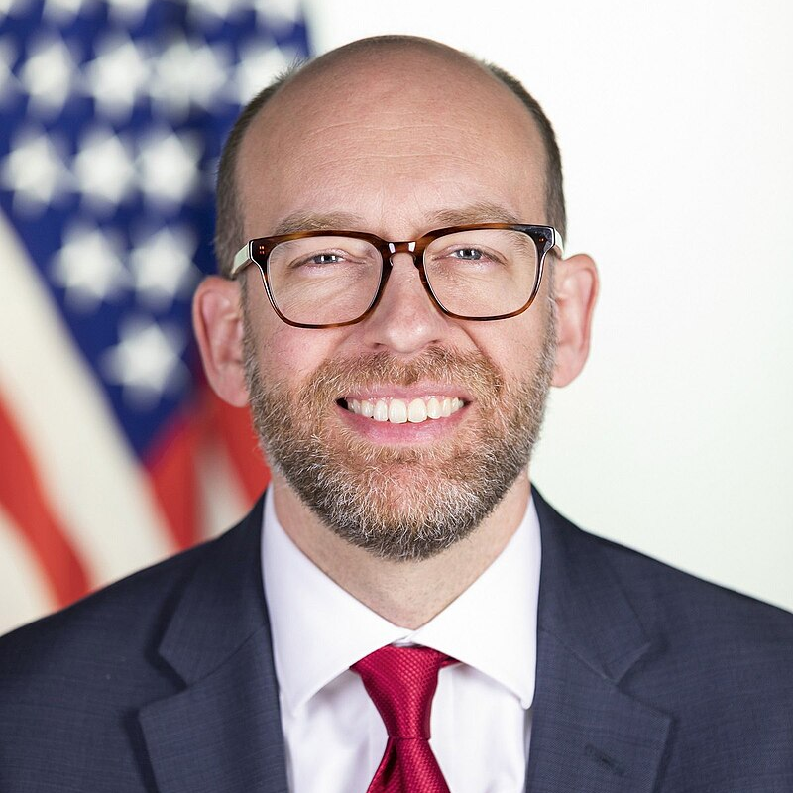
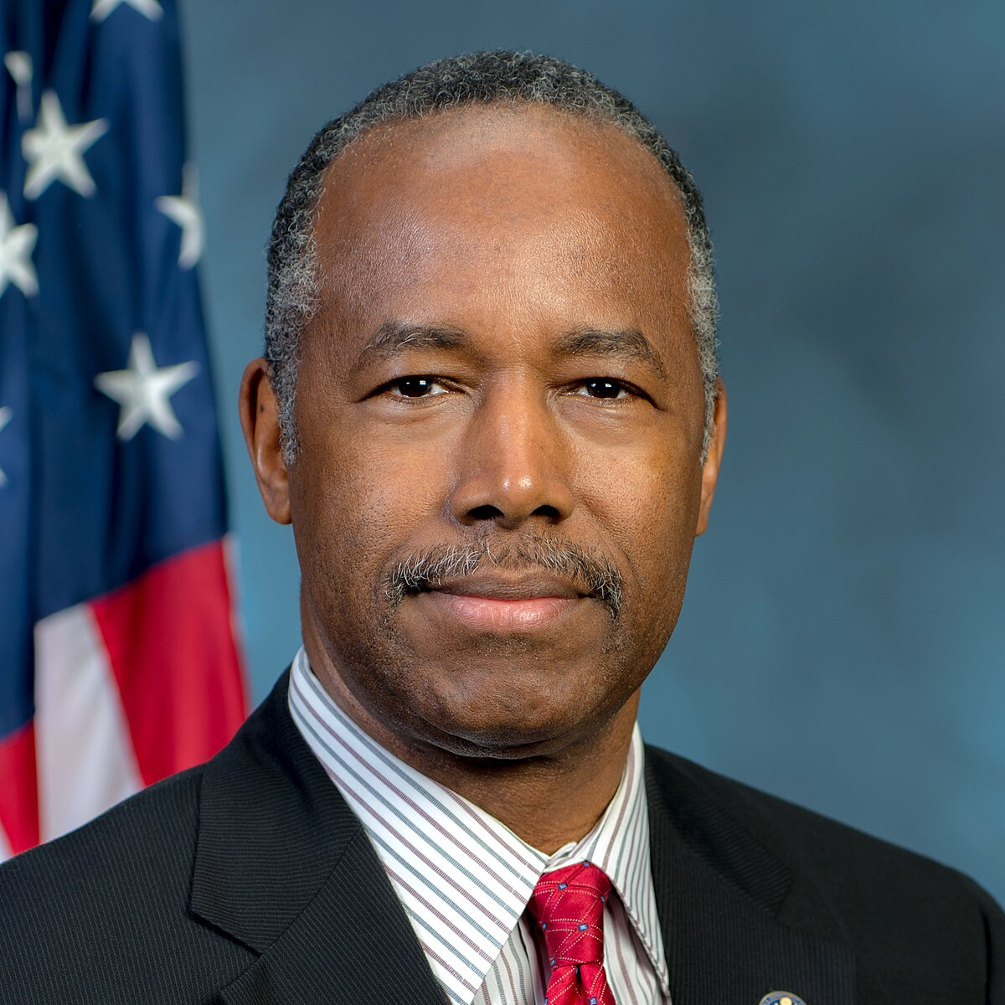
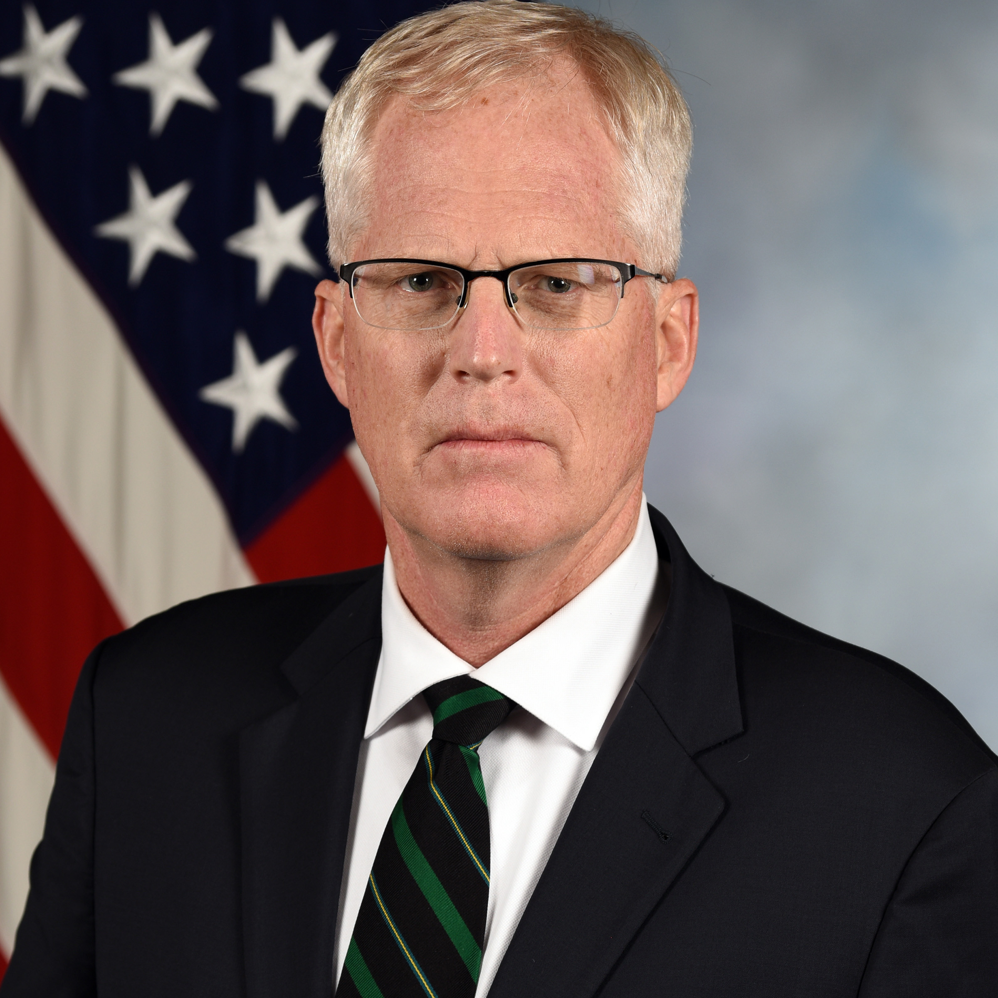
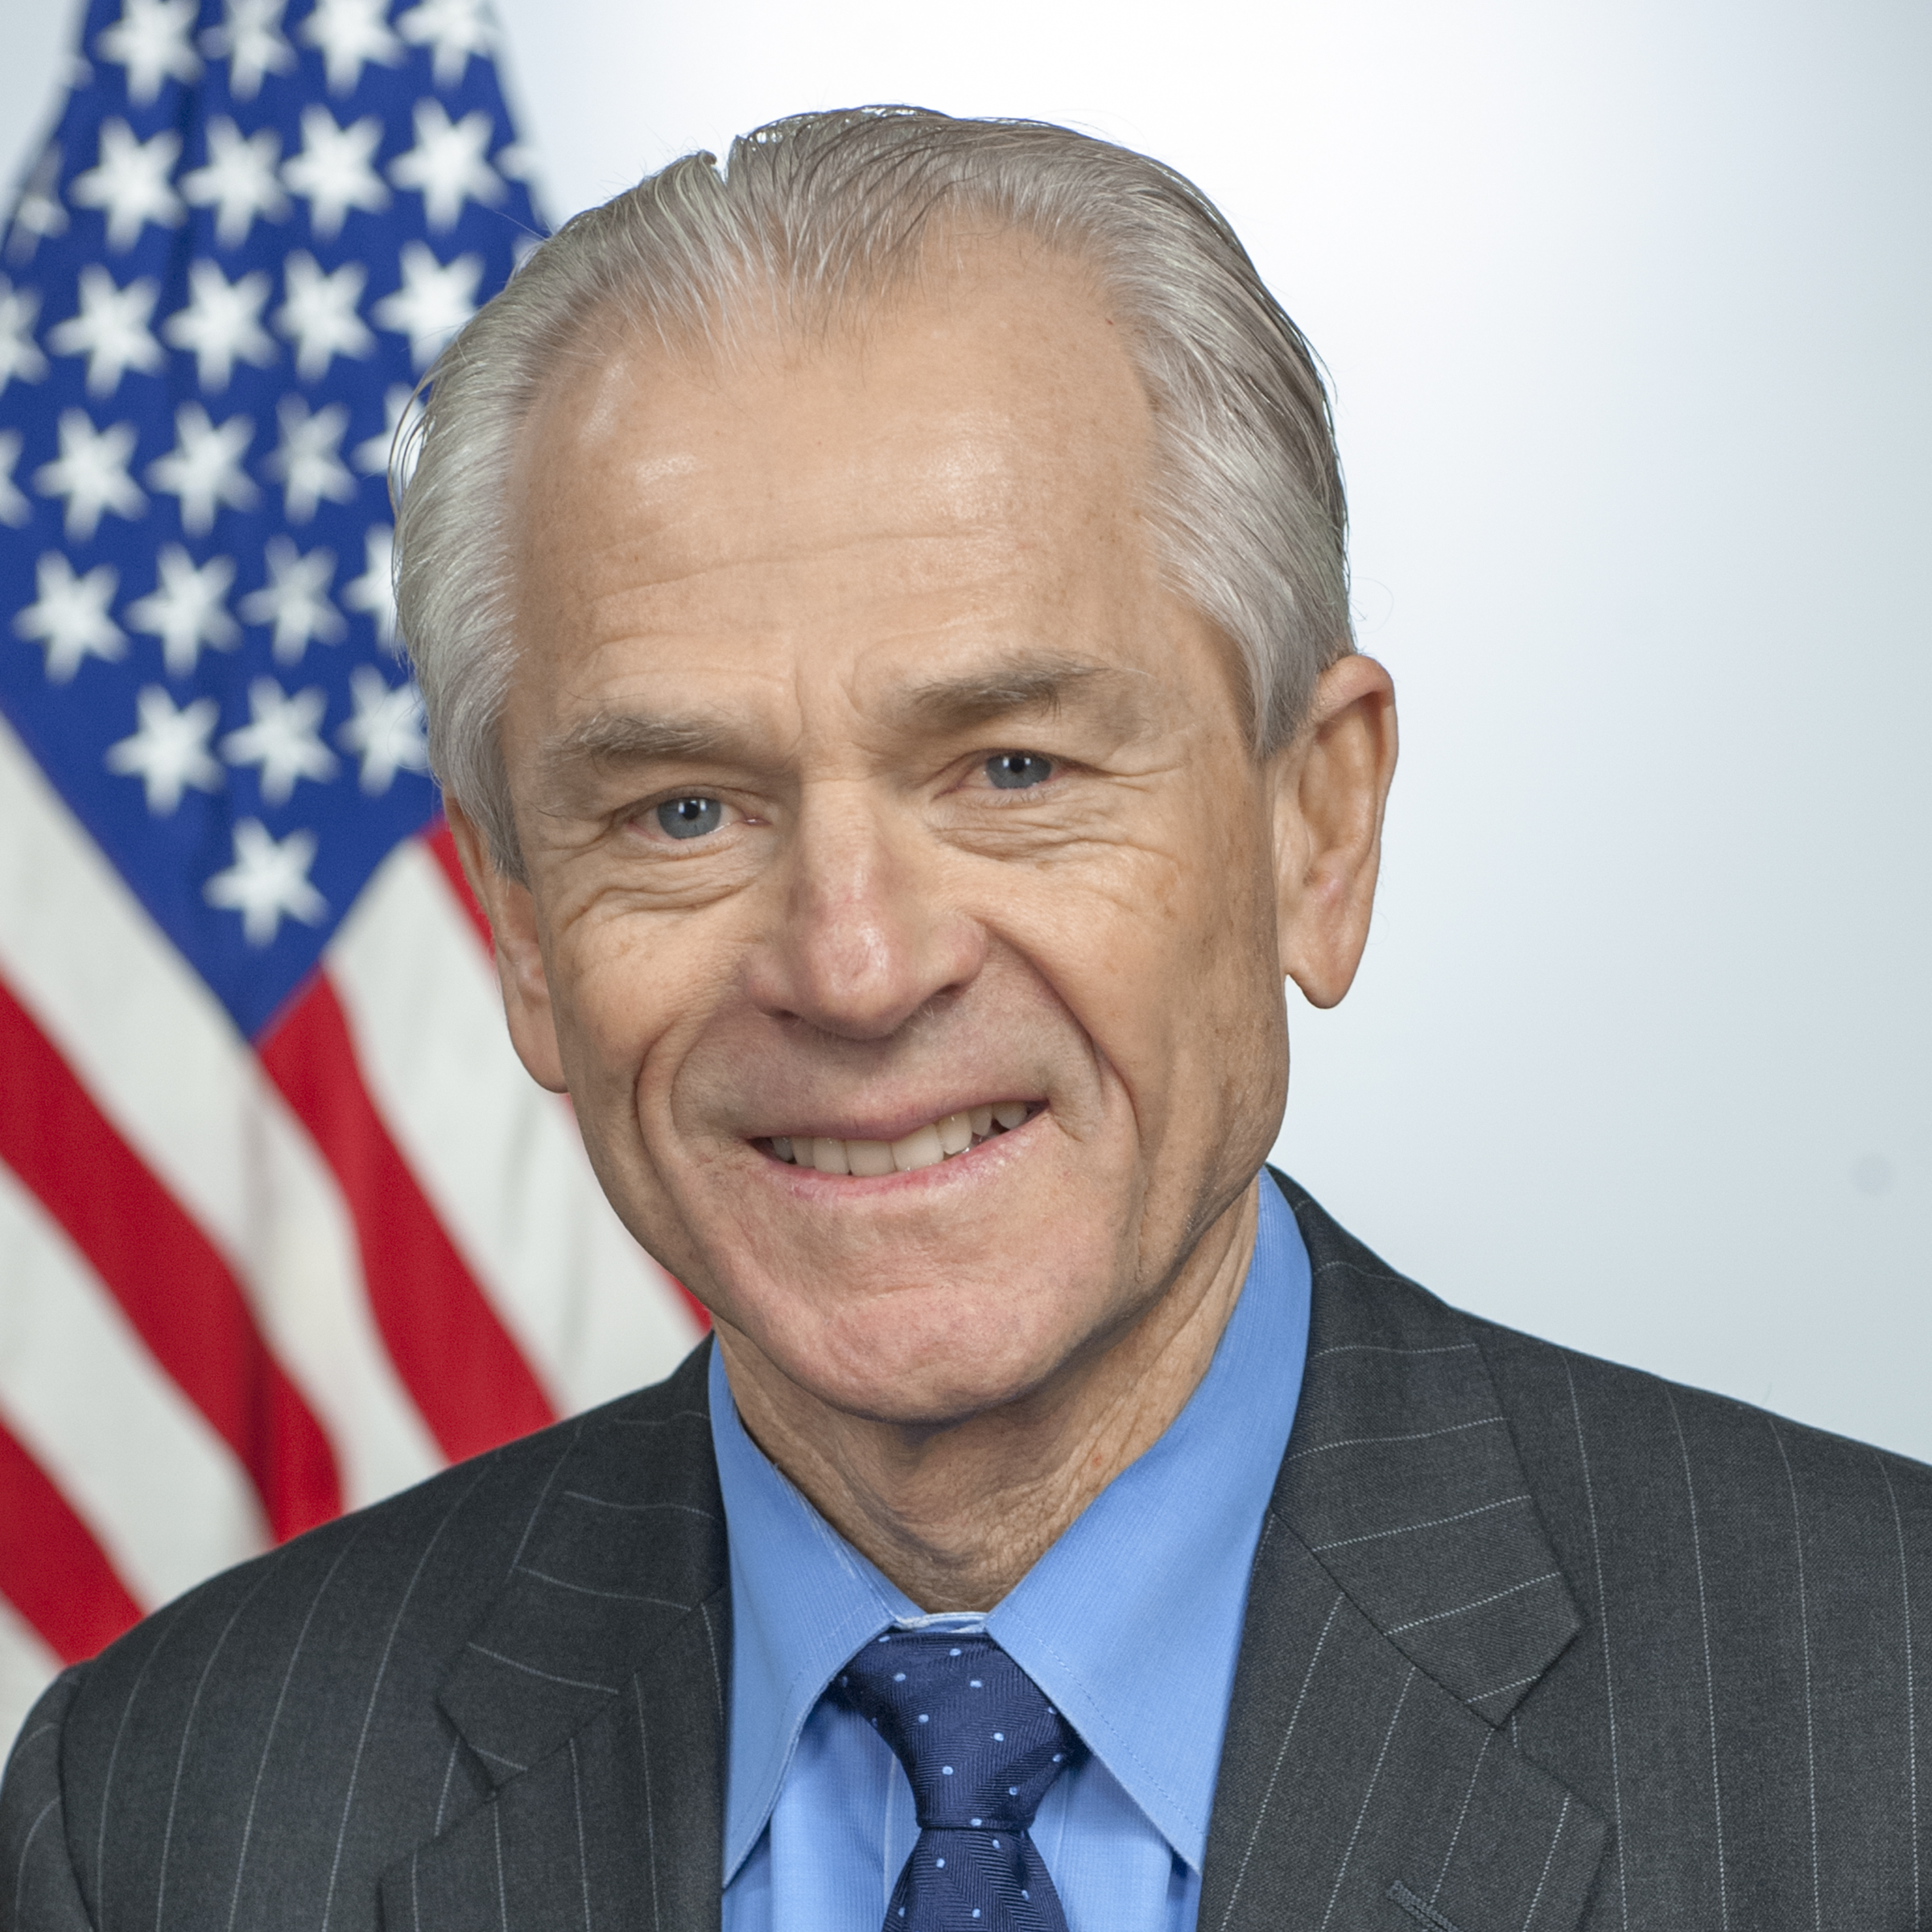
Several authors of Project 2025 formerly served in the Trump administration
PROJECT 2025 SPOTLIGHT
Russ Vought
Former Trump administration Director of the Office of Budget and Management
…a President today assumes office to find a sprawling federal bureaucracy that all too often is carrying out its own policy plans and preferences—or, worse yet, the policy plans and preferences of a radical, supposedly 'woke' faction of the country.”
–Russ Vought
Benjamin S. Carson Sr., MD
Former Trump administration Secretary of Housing and Urban Development
"A new conservative Administration will therefore need to reset HUD, including a broad reversal of the Biden Administration’s persistent implementation of corrosive progressive ideologies across the department’s programs.“
–Benjamin S. Carson, MD
Christopher Miller
Former Trump administration Acting Secretary of Defense
"Our disastrous withdrawal from Afghanistan, our impossibly muddled China strategy, and the growing involvement of senior military officers in the political arena are clear signals of a disturbing decay and markers of a dangerous decline in our nation’s capabilities and will.“
–Christopher Miller
Peter Navarro
Former Trump administration Director of Trade and Manufacturing Policy
"To maintain that global positioning—and thereby best protect the homeland and our own democratic institutions—it is critical that the United States strengthen its manufacturing and defense industrial base.“
–Peter Navarro
SOURCE Project 2025, The Heritage Project, Competitive Enterprise Institute, The Progress & Freedom Foundation.
PRESENTATION CENTER 7/18/24
Notes:
Sources:
“Russ Vought,” National Journal, Accessed June 18, 2024, https://www.nationaljournal.com/vignette/profile/580-russ-vought
“Kent Lassman,” Competitive Enterprise Institute, Accessed June 18, 2024, https://cei.org/experts/kent-lassman/
“The Digital Age Communications Act Project,” The Progress & Freedom Foundation, Accessed June 18, 2024, http://www.pff.org/daca/workinggroups.html
“David R. Burton,” The Heritage Project, Accessed June 18, 2024, https://www.heritage.org/staff/david-r-burton
“Diana Furchtgott-Roth,” The Heritage Project, Accessed June 18, 2024, https://www.heritage.org/staff/diana-furchtgott-roth
Russ Vought, “Project 2025,” Accessed June 20, 2024, https://static.project2025.org/2025_MandateForLeadership_FULL.pdf
Benjamin Carson Sr, “Project 2025,” Accessed June 20, 2024, https://static.project2025.org/2025_MandateForLeadership_FULL.pdf
Christopher Miller, “Project 2025,” Accessed June 20, 2024, https://static.project2025.org/2025_MandateForLeadership_FULL.pdf
Peter Navarro, “Project 2025,” Accessed June 20, 2024, https://static.project2025.org/2025_MandateForLeadership_FULL.pdf

Slide 7
Veterans and Armed Services Specific Impacts of Project 2025
Federal Employment Impacts
Prioritizing Political Loyalty Over Expertise
Housing Security, Cuts to BAH
Revision in Disability Ratings
Privatization of Care Facilities
Eliminating Diversity, Equity and Inclusion Programs

Slide 8
Federal Employment Impacts
AFGE estimates that up to 1 million federal jobs could be eliminated from Project 2025 implementation.
According to Government Executive, this number could be higher- as much as 75% of federal jobs within 4 years.
The federal government is estimated to employ 300,000 veterans.

Slide 9
Political Loyalty Over Expertise
Project 2025 not only calls for the elimination of thousands of government employees- but would replace them with political appointees.

Slide 10
Housing Security for Veterans, BAH Reform
Project 2025 includes proposals that would reduce funding and/or increase requirements for affordable housing. This could have a devastating effect were it to extend to HUD-Veterans Affairs Supportive Housing (VASH) which provides vouchers to homeless veterans.
Notably, Heritage Foundation has also called for Basic Allowance for Housing reform, noting that “servicemembers are not entitled to- and should not be able to- retain “extra compensation” from money above what they pay for housing”. (2023 Budget Blueprint)

Slide 11
Disability Ratings
Project 2025 proposes to reduce medical conditions that service members can claim, stating “VA Schedule of Rating Disabilities has assigned disability ratings to a growing number of health conditions over time… some are tenuously related or wholly unrelated to military service…The further growth in presumptive service-connected medical conditions pursued by Congress and [VSOs] begun with Agent Orange and most recently for Burn Pits/Airborne Toxins…”
This is extremely problematic for many reasons- it ultimately undermines the promise made to veterans when they agreed to serve.

Slide 12
Privatization of Care Facilities
“Project 2025 threatens to dismantle the VA healthcare system”. – Senator Kelly
Push for Privatization: Project 2025 advocates for outsourcing veteran care and other public services to private facilities, claiming it will increase efficiency and reduce government spending.
Potential Risks:
Higher Costs and Less Oversight: Privatizing care could lead to higher costs for services without the same quality control as government-managed programs like the VA.
Downsizing of VA Hospitals: The move could result in the closure or downsizing of key VA hospitals, threatening access to specialized care tailored to veterans’ unique needs.
Impact on Veterans and Workers:
Loss of Veteran-Focused Services: Veterans and other public sector employees could lose access to services that understand their specific health and employment needs.
Weakened Worker Protections: Privatization could erode the protections and benefits of public employees, including pensions, job security, and fair wages.

Slide 13
Eliminating DEI Programs
Project 2025 calls for the removal of Diversity, Equity and Inclusion initiatives across federal agencies and public institutions.
This will reduce efforts made to increase diversity, exacerbate inequalities, weaken innovation, and lower morale.

Slide 14
THANK YOU!

